Slide 2
Основы Maven
5. Свойства и Фильтрование

Slide 3
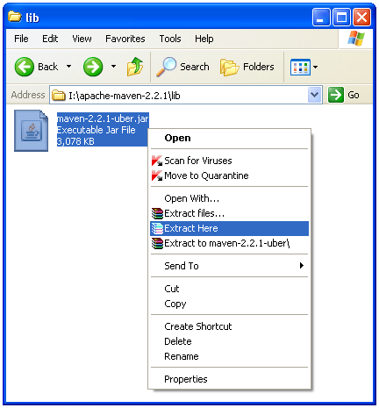
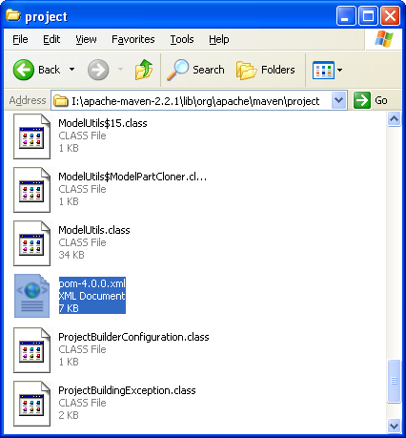

Посмотрим супер POM файл
 | Если разархивировать maven-2.2.1-uber.jar в директории org\apache\maven\project можно найти супер-POM в файле pom-4.0.0.xml.

Slide 4
Свойства в супер POM файле
<project>
[...]
<build>
[...]
<directory>${project.basedir}/target</directory>
<outputDirectory>${project.build.directory}/classes</outputDirectory>
<finalName>${project.artifactId}-${project.version}</finalName>
<testOutputDirectory>${project.build.directory}/test-classes</testOutputDirectory>
<sourceDirectory>${project.basedir}/src/main/java</sourceDirectory>
<testSourceDirectory>${project.basedir}/src/test/java</testSourceDirectory>
<resources>
<resource>
<directory>${project.basedir}/src/main/resources</directory>
</resource>
</resources>
<testResources>
<testResource>
<directory>${project.basedir}/src/test/resources</directory>
</testResource>
</testResources>
[...]
</build>
<reporting>
<outputDirectory>${project.build.directory}/site</outputDirectory>
</reporting>
</project>
${project.basedir}
${project.build.directory}
${project.artifactId}
${project.version}
${project.build.directory}
${project.basedir}
${project.basedir}
${project.basedir}
${project.basedir}
${project.build.directory}

Slide 5
Попытка получить эффективную конфигурацию
I:\maven-space\5.prop-superpom>mvn help:effective-pom -Doutput=effective.xml
[INFO] Scanning for projects...
[INFO] Searching repository for plugin with prefix: 'help'.
[INFO] ------------------------------------------------------------------------
[INFO] Building calculator
[INFO] task-segment: [help:effective-pom] (aggregator-style)
[INFO] ------------------------------------------------------------------------
[INFO] [help:effective-pom {execution: default-cli}]
[INFO] Effective-POM written to: I:\maven-space\5.prop-superpom\effective.xml
[INFO] ------------------------------------------------------------------------
[INFO] BUILD SUCCESSFUL
[INFO] ------------------------------------------------------------------------
[INFO] Total time: 1 second
[INFO] Finished at: Tue Jul 02 10:48:47 NOVT 2013
[INFO] Final Memory: 10M/26M
[INFO] ------------------------------------------------------------------------
I:\maven-space\5.prop-superpom>
mvn help:effective-pom -Doutput=effective.xml
I:\maven-space\5.prop-superpom\effective.xml

Slide 6
Эффективный POM файл
<project>
[...]
<build>
[...]
<directory>I:\maven-space\5.prop-superpom\target</directory>
<outputDirectory>I:\maven-space\5.prop-superpom\target\classes</outputDirectory>
<finalName>calculator-0.0.1</finalName>
<testOutputDirectory>I:\maven-space\5.prop-superpom\target\test-classes</testOutputDirectory>
<sourceDirectory>I:\maven-space\5.prop-superpom\src\main\java</sourceDirectory>
<testSourceDirectory>I:\maven-space\5.prop-superpom\src\test\java</testSourceDirectory>
<resources>
<resource>
<directory>I:\maven-space\5.prop-superpom\src\main\resources</directory>
</resource>
</resources>
<testResources>
<testResource>
<directory>I:\maven-space\5.prop-superpom\src\test\resources</directory>
</testResource>
</testResources>
[...]
</build>
<reporting>
<outputDirectory>D:\simple\target\site</outputDirectory>
</reporting>
</project>
${project.build.directory}

Slide 7
Свойства

Slide 8


Свойства
 | Свойство – поле для подстановки значений. Значение свойства можно получить в POM файле используя ${X}, где X свойство.

Slide 9
Встроенное свойство basedir
Свойство | Описание
project.basedir | Директория содержащая pom.xml
 | В супер POM файле используется встроенное свойство project.basedir значение которого равно корневой директории проекта (директории содержащей POM файл). Все остальные директории по умолчанию определяются на основании этой директории.

Slide 10
Свойства
Свойство | Описание
env.X | Переменные среды
settings.X | Значения элементов конфигурационного файла
project.X | Значения элементов POM файла
java.X | Свойства доступные с помощью вызова метода java.lang.System.getProperties()
X | Свойства заданные в элементе <properties />

Slide 11

Свойства
Свойство | Описание
project.groupId | Идентификатор группы
project.version | Версия проекта
project.name | Имя проекта
project.description | Описание проекта
project.build.sourceDirectory | Директория с исходным кодом
project.build.outputDirectory | Директория для байт кода
 | Не следует использовать литералы такие как “target/classes”. Вместо них следует использовать свойства такие как ${project.build.outputDirectory}.

Slide 12
Задание имени артефакта
<project>
[...]
<build>
<finalName>
${project.artifactId}
</finalName>
</build>
[...]
</project>
 | Идентификатор артефакта проекта часто используется как название продукта без информации о версии. Для этого можно использовать project.artifactId в POM файле.

Slide 13
Задание имени артефакта
I:\maven-space\5.prop-finalname>mvn package -DskipTests
[INFO] Scanning for projects...
[INFO] ------------------------------------------------------------------------
[INFO] Building calculator
[INFO] task-segment: [package]
[INFO] ------------------------------------------------------------------------
[INFO] [resources:resources {execution: default-resources}]
[INFO] Using 'UTF-8' encoding to copy filtered resources.
[INFO] skip non existing resourceDirectory I:\maven-space\5.prop-finalname\src\main\resources
[INFO] [compiler:compile {execution: default-compile}]
[INFO] Compiling 1 source file to I:\maven-space\5.prop-finalname\target\classes
[INFO] [resources:testResources {execution: default-testResources}]
[INFO] Using 'UTF-8' encoding to copy filtered resources.
[INFO] skip non existing resourceDirectory I:\maven-space\5.prop-finalname\src\test\resources
[INFO] [compiler:testCompile {execution: default-testCompile}]
[INFO] Compiling 1 source file to I:\maven-space\5.prop-finalname\target\test-classes
[INFO] [surefire:test {execution: default-test}]
[INFO] Tests are skipped.
[INFO] [jar:jar {execution: default-jar}]
[INFO] Building jar: I:\maven-space\5.prop-finalname\target\calculator.jar
[INFO] ------------------------------------------------------------------------
[INFO] BUILD SUCCESSFUL
[INFO] ------------------------------------------------------------------------
[INFO] Total time: 3 seconds
[INFO] Finished at: Tue Jul 02 11:29:45 NOVT 2013
[INFO] Final Memory: 14M/33M
[INFO] ------------------------------------------------------------------------
I:\maven-space\5.prop-finalname>
mvn package -DskipTests
Building jar: I:\maven-space\5.prop-finalname\target\calculator.jar

Slide 14
Определение свойств в POM

Slide 15
Определение свойств в POM
<project>
[...]
<properties>
<cayenne.artifactId> cayenne </cayenne.artifactId>
</properties>
<dependencies>
<dependency>
<groupId>junit</groupId>
<artifactId>junit</artifactId>
<version>4.8.2</version>
<scope>test</scope>
</dependency>
<dependency>
<groupId>org.apache.cayenne</groupId>
<artifactId> ${cayenne.artifactId}</artifactId>
<version>2.0.4</version>
</dependency>
</dependencies>
[...]
</project>
cayenne
${cayenne.artifactId}

Slide 16
Задание имени артефакта
I:\maven-space\5.prop-dependency>mvn package
[INFO] Scanning for projects...
[INFO] ------------------------------------------------------------------------
[INFO] Building calculator
[INFO] task-segment: [package]
[INFO] ------------------------------------------------------------------------
[INFO] [resources:resources {execution: default-resources}]
[INFO] Using 'UTF-8' encoding to copy filtered resources.
[INFO] skip non existing resourceDirectory I:\maven-space\5.prop-dependency\src\main\resources
Downloading: http://repo1.maven.org/maven2/org/apache/cayenne/cayenne/2.0.4/cayenne-2.0.4.pom
1K downloaded (cayenne-2.0.4.pom)
Downloading: http://repo1.maven.org/maven2/org/apache/cayenne/cayenne/2.0.4/cayenne-2.0.4.jar
2854K downloaded (cayenne-2.0.4.jar)
[INFO] [compiler:compile {execution: default-compile}]
...
[INFO] [jar:jar {execution: default-jar}]
[INFO] Building jar: I:\maven-space\5.prop-dependency\target\calculator-1.2.3.jar
[INFO] ------------------------------------------------------------------------
[INFO] BUILD SUCCESSFUL
[INFO] ------------------------------------------------------------------------
[INFO] Total time: 8 seconds
[INFO] Finished at: Wed Jul 03 10:46:34 NOVT 2013
[INFO] Final Memory: 9M/22M
[INFO] ------------------------------------------------------------------------
I:\maven-space\5.prop-dependency>
mvn package
cayenne-2.0.4.pom
(cayenne-2.0.4.pom)
cayenne-2.0.4.jar
(cayenne-2.0.4.jar)

Slide 17
Определение свойств в профиле POM
<project>
...
<profiles>
<profile>
<id>myProfile</id>
<properties>
<cayenne.artifactId> cayenne-nodeps </cayenne.artifactId>
</properties>
</profile>
</profiles>
...
</project>
cayenne-nodeps

Slide 18
Задание имени артефакта
I:\maven-space\5.prop-dependency>mvn package -PmyProfile
[INFO] Scanning for projects...
[INFO] ------------------------------------------------------------------------
[INFO] Building calculator
[INFO] task-segment: [package]
[INFO] ------------------------------------------------------------------------
[INFO] [resources:resources {execution: default-resources}]
[INFO] Using 'UTF-8' encoding to copy filtered resources.
[INFO] skip non existing resourceDirectory I:\maven-space\5.prop-dependency\src\main\resources
Downloading: http://repo1.maven.org/maven2/org/apache/cayenne/cayenne-nodeps/2.0.4/cayenne-nodeps-2.0.4.pom
2K downloaded (cayenne-nodeps-2.0.4.pom)
[...]
Downloading: http://repo1.maven.org/maven2/org/apache/cayenne/cayenne-nodeps/2.0.4/cayenne-nodeps-2.0.4.jar
105K downloaded (ashwood-1.1.jar)
344K downloaded (log4j-1.2.8.jar)
546K downloaded (commons-collections-3.1.jar)
498K downloaded (velocity-dep-1.3.1.jar)
1411K downloaded (cayenne-nodeps-2.0.4.jar)
[...]
[INFO] [jar:jar {execution: default-jar}]
[INFO] Building jar: I:\maven-space\5.prop-dependency\target\calculator-0.0.1.jar
[INFO] ------------------------------------------------------------------------
[INFO] BUILD SUCCESSFUL
[INFO] ------------------------------------------------------------------------
[INFO] Total time: 9 seconds
[INFO] Finished at: Wed Jul 03 11:00:59 NOVT 2013
[INFO] Final Memory: 9M/23M
[INFO] ------------------------------------------------------------------------
I:\maven-space\5.prop-dependency>
mvn package -PmyProfile
cayenne-nodeps-2.0.4.pom
cayenne-nodeps-2.0.4.jar
(cayenne-nodeps-2.0.4.jar)

Slide 19
Фильтрование ресурсов

Slide 20

Фильтрование ресурсов
 | Фильтрование ресурсов – замена ссылок на свойства в файлах ресурсов на значения свойств. По умолчанию фильтрование отключено для предотвращения случайной замены ссылок на свойства. По умолчанию ресурсы находятся в каталоге src/main/resources.

Slide 21
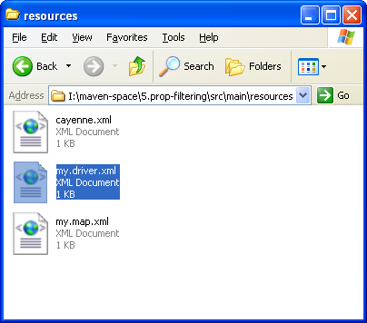
Использование свойств в ресурсе
<?xml version="1.0" encoding="utf-8" ?>
<driver project-version="2.0" class="${jdbc.driverClassName}">
<url value="${jdbc.url}" />
<connectionPool min="1" max="1" />
<login userName="${jdbc.username}" password="${jdbc.password}" />
</driver>

Slide 22
Определение свойств и задание фильтрования
<project>
[...]
<properties>
<jdbc.driverClassName>com.mysql.jdbc.Driver</jdbc.driverClassName>
<jdbc.url>jdbc:mysql://localhost:3306/development_db</jdbc.url>
<jdbc.username>dev_user</jdbc.username>
<jdbc.password>s3cr3tw0rd</jdbc.password>
</properties>
[...]
<build>
<resources>
<resource>
<directory>src/main/resources</directory>
<filtering>true</filtering>
</resource>
</resources>
</build>
[...]
</project>
<filtering>true</filtering>

Slide 23
Выполнение фильтрования
I:\maven-space\5.prop-filtering>mvn package -DskipTests
[INFO] Scanning for projects...
[INFO] ------------------------------------------------------------------------
[INFO] Building calculator
[INFO] task-segment: [package]
[INFO] ------------------------------------------------------------------------
[INFO] [resources:resources {execution: default-resources}]
[INFO] Using 'UTF-8' encoding to copy filtered resources.
[INFO] Copying 3 resources
[INFO] [compiler:compile {execution: default-compile}]
[INFO] Compiling 1 source file to I:\maven-space\5.prop-filtering\target\classes
[INFO] [resources:testResources {execution: default-testResources}]
[INFO] Using 'UTF-8' encoding to copy filtered resources.
[INFO] skip non existing resourceDirectory I:\maven-space\5.prop-filtering\src\test\resources
[INFO] [compiler:testCompile {execution: default-testCompile}]
[INFO] Compiling 1 source file to I:\maven-space\5.prop-filtering\target\test-classes
[INFO] [surefire:test {execution: default-test}]
[INFO] Tests are skipped.
[INFO] [jar:jar {execution: default-jar}]
[INFO] Building jar: I:\maven-space\5.prop-filtering\target\calculator-0.0.1.jar
[INFO] ------------------------------------------------------------------------
[INFO] BUILD SUCCESSFUL
[INFO] ------------------------------------------------------------------------
[INFO] Total time: 1 second
[INFO] Finished at: Tue Jul 02 16:51:59 NOVT 2013
[INFO] Final Memory: 14M/33M
[INFO] ------------------------------------------------------------------------
I:\maven-space\5.prop-filtering>
mvn package -DskipTests
[INFO] [resources:resources {execution: default-resources}]
[INFO] Using 'UTF-8' encoding to copy filtered resources.
[INFO] Copying 3 resources

Slide 24
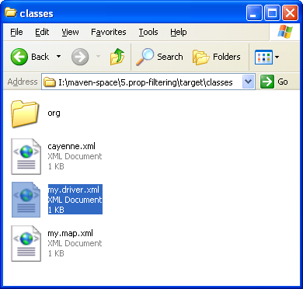
Результат фильтрования
<?xml version="1.0" encoding="utf-8" ?>
<driver project-version="2.0" class="com.mysql.jdbc.Driver">
<url value="jdbc:mysql://localhost:3306/development_db" />
<connectionPool min="1" max="1" />
<login userName="dev_user" password="s3cr3tw0rd" />
</driver>

Slide 25
Определение свойств и задание фильтрования
<project>
...
<properties>
<jdbc.driverClassName>com.mysql.jdbc.Driver</jdbc.driverClassName>
<jdbc.url>jdbc:mysql://localhost:3306/development_db</jdbc.url>
<jdbc.username>dev_user</jdbc.username>
<jdbc.password>s3cr3tw0rd</jdbc.password>
</properties>
...
<build>
<resources>
<resource>
<directory>src/main/resources</directory>
<filtering>true</filtering>
</resource>
</resources>
</build>
...
<profiles>
<profile>
<id>production</id>
<properties>
<jdbc.driverClassName>oracle.jdbc.driver.OracleDriver</jdbc.driverClassName>
<jdbc.url>jdbc:oracle:thin:@proddb01:1521:PROD</jdbc.url>
<jdbc.username>prod_user</jdbc.username>
<jdbc.password>s00p3rs3cr3t</jdbc.password>
</properties>
</profile>
</profiles>
</project>
<filtering>true</filtering>

Slide 26
Выполнение фильтрования
I:\maven-space\5.prop-filtering>mvn package -Pproduction -DskipTests
[INFO] Scanning for projects...
[INFO] ------------------------------------------------------------------------
[INFO] Building calculator
[INFO] task-segment: [package]
[INFO] ------------------------------------------------------------------------
[INFO] [resources:resources {execution: default-resources}]
[INFO] Using 'UTF-8' encoding to copy filtered resources.
[INFO] Copying 3 resources
[INFO] [compiler:compile {execution: default-compile}]
[INFO] Compiling 1 source file to I:\maven-space\5.prop-filtering\target\classes
[INFO] [resources:testResources {execution: default-testResources}]
[INFO] Using 'UTF-8' encoding to copy filtered resources.
[INFO] skip non existing resourceDirectory I:\maven-space\5.prop-filtering\src\test\resources
[INFO] [compiler:testCompile {execution: default-testCompile}]
[INFO] Compiling 1 source file to I:\maven-space\5.prop-filtering\target\test-classes
[INFO] [surefire:test {execution: default-test}]
[INFO] Tests are skipped.
[INFO] [jar:jar {execution: default-jar}]
[INFO] Building jar: I:\maven-space\5.prop-filtering\target\calculator-0.0.1.jar
[INFO] ------------------------------------------------------------------------
[INFO] BUILD SUCCESSFUL
[INFO] ------------------------------------------------------------------------
[INFO] Total time: 3 seconds
[INFO] Finished at: Tue Jul 02 16:45:56 NOVT 2013
[INFO] Final Memory: 14M/33M
[INFO] ------------------------------------------------------------------------
I:\maven-space\5.prop-filtering>
mvn package -Pproduction -DskipTests
[INFO] [resources:resources {execution: default-resources}]
[INFO] Using 'UTF-8' encoding to copy filtered resources.
[INFO] Copying 3 resources

Slide 27
Результат фильтрования
<?xml version="1.0" encoding="utf-8" ?>
<driver project-version="2.0" class="oracle.jdbc.driver.OracleDriver">
<url value="jdbc:oracle:thin:@proddb01:1521:PROD" />
<connectionPool min="1" max="1" />
<login userName="prod_user" password="s00p3rs3cr3t" />
</driver>

